Slide 1


A Project Phase - II Presentation
on
“IoT based Smart Campus”
Students:
1.Nishitha Pal 1RN14CS062
2.R. Saiprasanth 1RN14CS075
3.Soorya Sahar P N 1RN14CS103
4.Spoorthi.S 1RN14CS105
Guide:
Prof. Devraju B.M
Asst. Prof. Dept. of CSE, RNSIT
Department of Computer Science and Engineering
RNS Institute of Technology
2018

Slide 2
CONTENTS
INTRODUCTION
SYSTEM ARCHITECTURE
SOFTWARE REQUIREMENTS
HARDWARE REQUIREMENTS
SYSTEM DESIGN
MERTITS OF THE SYSTEM
DEMERITS OF THE SYSTEM
CONCLUSION
REFERENCES

Slide 3
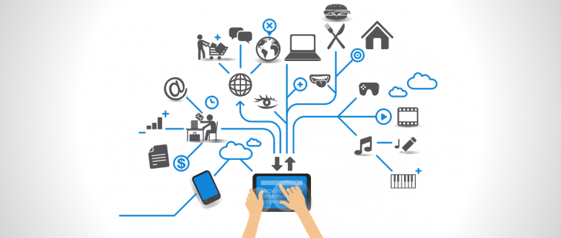
INTRODUCTION
IoT Based Smart Campus
The Internet of Things (IoT) is the network of physical objects—devices, vehicles, buildings and other items embedded with electronics, software, sensors, and network connectivity—that enables these objects to collect and exchange data.
IoT aims at building a technology-driven and innovative world where ease of living is improved day-by-day with the help of its smart solutions.
Campus Bridge project is one such innovative solution
Smart Campus integrates various devices such as smartphones, RFID system, server, etc to provide an seamless and easier way of carrying out various college functionalities.
Radio-frequency identification (RFID) uses electromagnetic fields to automatically identify and track tags attached to objects. The tags contain electronically-stored information
Dept.of CSE,RNSIT 2017-2018

Slide 4
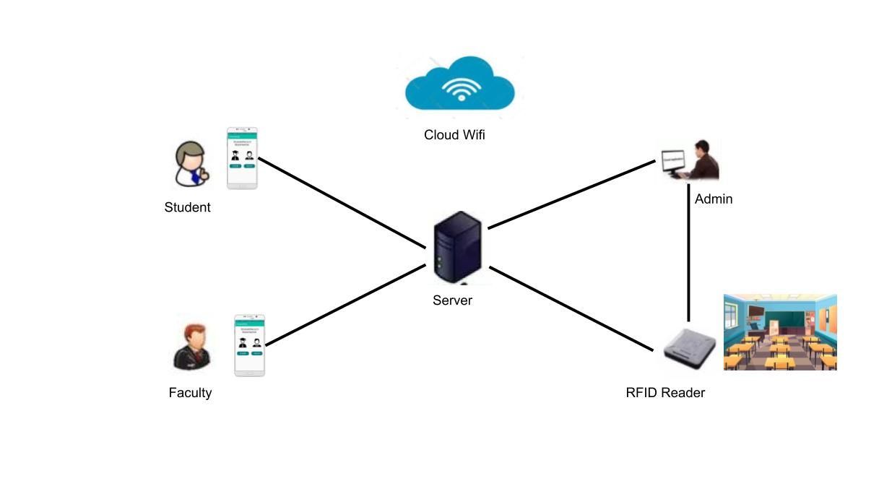
SYSTEM ARCHITECTURE
IoT Based Smart Campus
Dept.of CSE,RNSIT 2017-2018

Slide 5
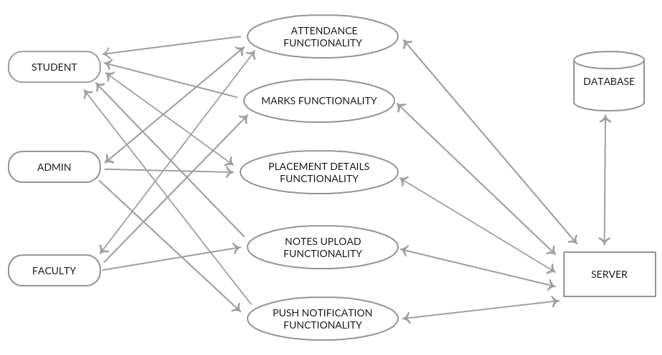
IoT Based Smart Campus
Dept.of CSE,RNSIT 2017-2018

Slide 6
SOFTWARE REQUIREMENTS
IoT Based Smart Campus
Java Development Kit Version 8 or more
Android Studio Version 3.0.1 or more
Apache-Tomcat Server
NetBeans IDE for Java Servlet Version 8.2 or more
MySql DB with Navicat IDE
OpenCV for Java
Firebase Cloud Messaging Beta Version
Dept.of CSE,RNSIT 2017-2018

Slide 7
HARDWARE REQUIREMENTS
IoT Based Smart Campus
Android Smart phone
RFID USB Reader
RFID tags
Faculty Phones with good quality camera
Dept.of CSE,RNSIT 2017-2018

Slide 8
SYSTEM DESIGN
IoT Based Smart Campus
Campus Bridge Project handles the major functionalities carried out in college with a more technology driven approach.
Some of the major modules are
Attendance Functionality
Marks Functionality
Placement Details Functionality
Notes Upload Functionality
Push Notifications Functionality
These represented as separate Activity Diagrams for each of the functionality.
Dept.of CSE,RNSIT 2017-2018

Slide 9
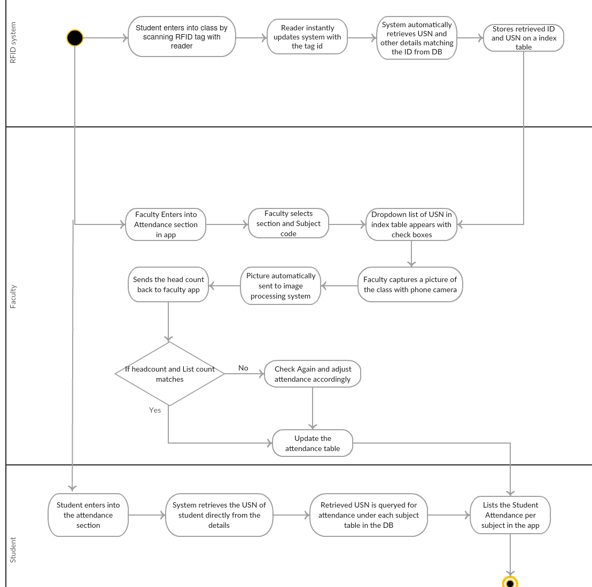
Attendance Functionality
IoT Based Smart Campus
Dept.of CSE,RNSIT 2017-2018

Slide 10
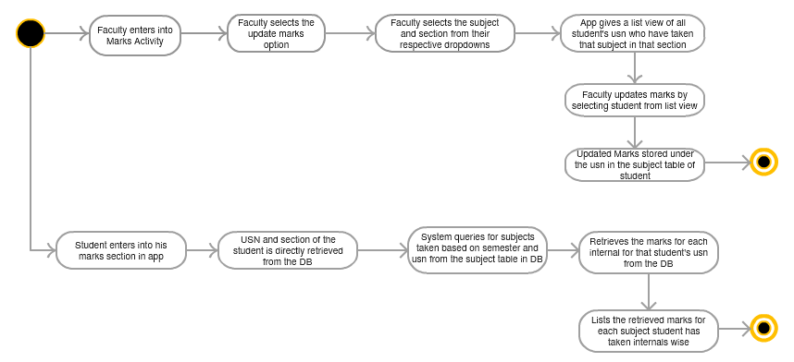
Marks Functionality
IoT Based Smart Campus
Dept.of CSE,RNSIT 2017-2018

Slide 11
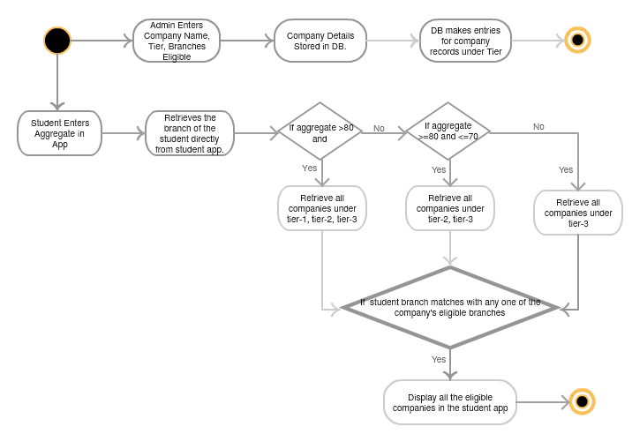
Placement Details Functionality
IoT Based Smart Campus
Dept.of CSE,RNSIT 2017-2018

Slide 12
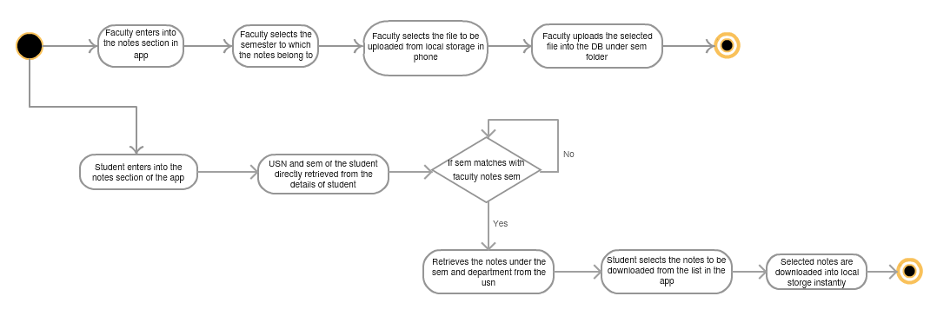
Notes Upload Functionality
IoT Based Smart Campus
Dept.of CSE,RNSIT 2017-2018

Slide 13
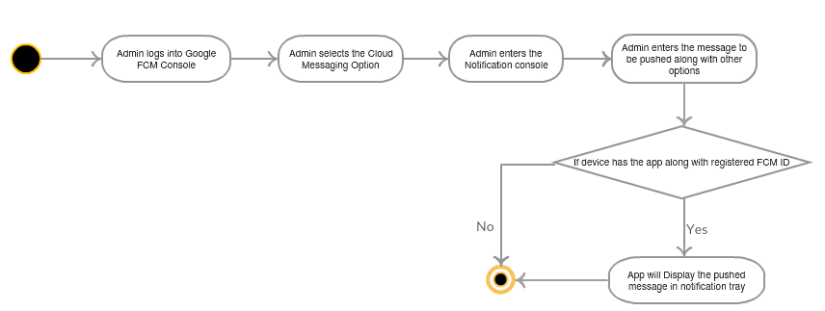
Push Notifications Functionality
IoT Based Smart Campus
Dept.of CSE,RNSIT 2017-2018

Slide 14



RESULTS
IoT Based Smart Campus
Dept.of CSE,RNSIT 2017-2018

Slide 15
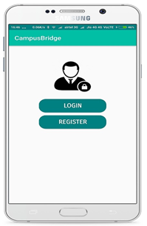
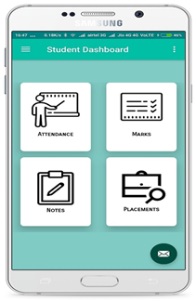
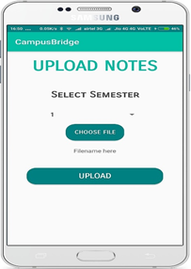
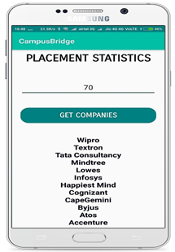
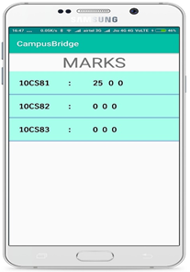
IoT Based Smart Campus

Slide 16
MERITS
IoT Based Smart Campus
The system provides an IoT based multi-platform system each of which are used widely today.
Could be scaled for many other spaces as well
Manual Work done has decreased by many folds.
Much More efficient and error-free solution compared to the current system
Transparent and steady flow of data as records with a stable database design
Secure Access and User friendly Interface
Dept.of CSE,RNSIT 2017-2018

Slide 17
DEMERITS
IoT Based Smart Campus
Might Require Double Checking in case of a proxy issue while attendance
Cost of Upgradation and Scaling could be expensive
Requires High Resolution Cameras for better Image processing results
Enhance our project by replacing the RFID USB reader which always needs to be connected with a system with a Wireless enabled RFID reader which is more efficient and makes the project more flexible and portable.
Dept.of CSE,RNSIT 2017-2018

Slide 18
CONCLUSION
IoT Based Smart Campus
As we are running towards a much smarter and technology driven world, Campus Bridge Project is a step in the right direction
It will not just provide efficient solutions to various day-to-day functionalities carried out in an educational institution, but also gives a scope to more technology driven approach to our educational system.
This project is not just about the end of the traditional ways of college working but more about the dawn of a new, modern and technology-driven approach so as to bridge the gap between students and campus.
Dept.of CSE,RNSIT 2017-2018

Slide 19
REFERENCES
Firebase Cloud Messaging Service Manual URL: https://firebase.google.com/
Manual Required for Java Servlet and database handling URL: https://www.javatpoint.com/
Intelligent Device-to-Device Communication in the Internet of Things Oladayo Bello, Member, IEEE, and Sherali Zeadally, Senior Member, IEEE, Dec 2013.
M.R.M.Veeramanickam, Dr. M. Mohanapriya., IoT enabled Futurus Smart Campus with effective E-Learning : I-Campus, GSTF Journal of Engineering Technology (JET) Vol.3 No.4, , pages 81-87, Apr. 2016.
Pranay Kujur and Kiran Gautam, "Smart Interaction of Object on Internet of Things", International Journal of Computer Sciences and Engineering, Volume-03, Issue-02, Page No (15-19), Feb -2015.

Slide 20
THANK YOU

Slide 21
Any Questions??

